Slide 1

CHAPTER -5
CONTINUITY
AND DIFFERENTIABILITY
MODULE : 2/4 e-content

Slide 2
PREVIOUS KNOWLEDGE
Continuity of functions
Evaluation of limit of functions
Definition of differentiation
Product rule and Quotient rule of differentiation

Slide 3
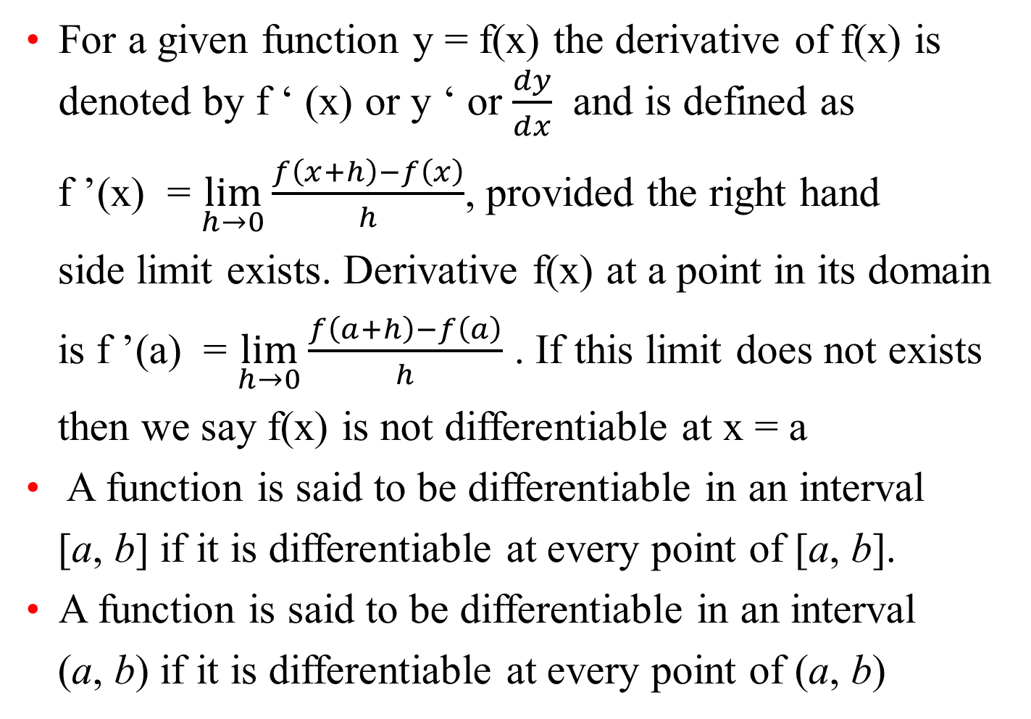
DIFFERENTIABILITY
For a given function y = f(x) the derivative of f(x) is denoted by f ‘ (x) or y ‘ or $\frac{dy}{dx}$ and is defined as
f ’(x) = $\lim_{h→0}{\frac{f\left(x+h\right)−f\left(x\right)}{h}}$, provided the right hand
side limit exists. Derivative f(x) at a point in its domain
is f ’(a) = $\lim_{h→0}{\frac{f\left(a+h\right)−f\left(a\right)}{h}}$ . If this limit does not exists
then we say f(x) is not differentiable at x = a
A function is said to be differentiable in an interval
[a, b] if it is differentiable at every point of [a, b].
A function is said to be differentiable in an interval
(a, b) if it is differentiable at every point of (a, b)

Slide 4
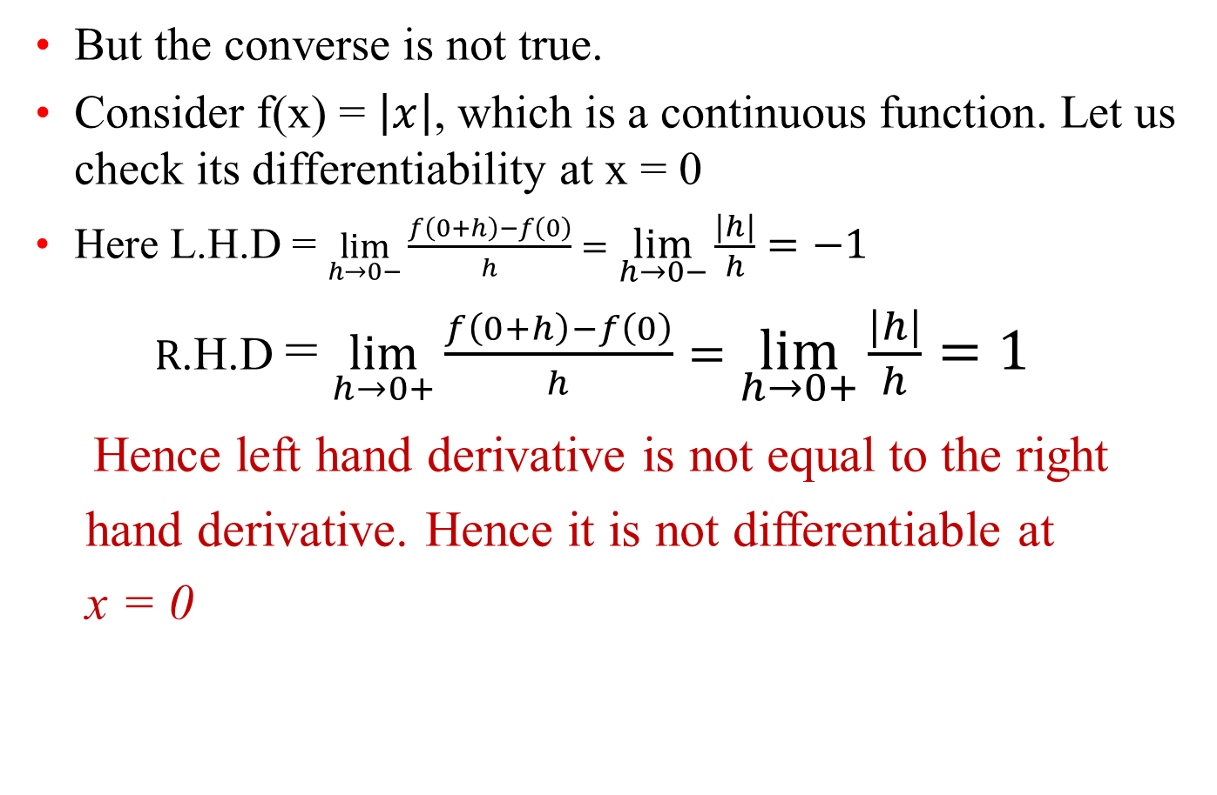
Theorem : If a function f is differentiable at a point c, then it is also continuous at that point. ie. Differentiability implies continuity
But the converse is not true.
Consider f(x) = $\left|x\right|$, which is a continuous function. Let us check its differentiability at x = 0
Here L.H.D = $\lim_{h→0−}{\frac{f\left(0+h\right)−f\left(0\right)}{h}}=\lim_{h→0−}{\frac{\left|h\right|}{h}}=−1$
$R$.H.D = $\lim_{h→0+}{\frac{f\left(0+h\right)−f\left(0\right)}{h}}=\lim_{h→0+}{\frac{\left|h\right|}{h}}=1$
Hence left hand derivative is not equal to the right
hand derivative. Hence it is not differentiable at
x = 0

Slide 5
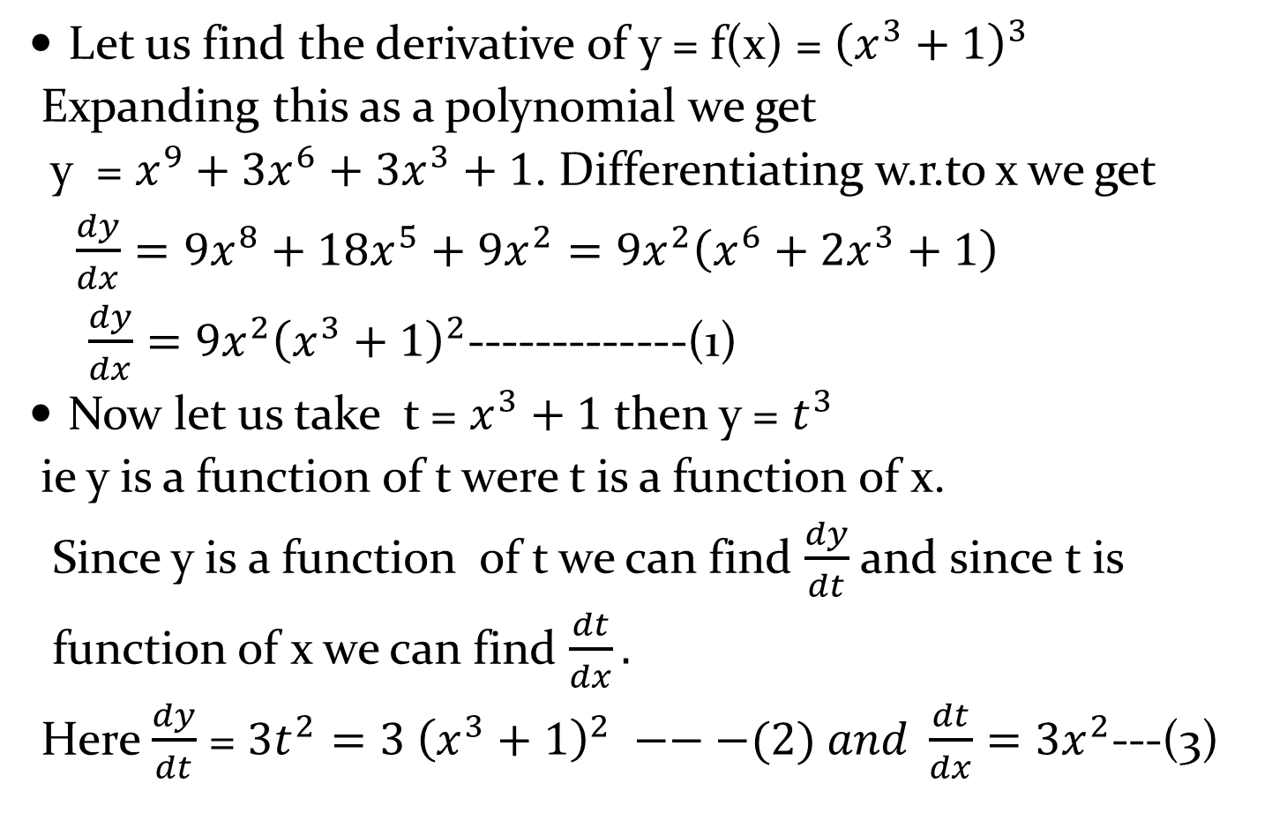
CHAIN RULE
( FUNCTION OF FUNCTION RULE)
Let us find the derivative of y = f(x) = ${\left(x^{3}+1\right)}^{3}$
Expanding this as a polynomial we get
y = $x^{9}+3x^{6}+3x^{3}+1$. Differentiating w.r.to x we get
$\frac{dy}{dx}=9x^{8}+18x^{5}+9x^{2}=9x^{2}\left(x^{6}+2x^{3}+1\right)$
$\frac{dy}{dx}=9x^{2}{\left(x^{3}+1\right)}^{2}$-------------(1)
Now let us take t = $x^{3}+1$ then y = $t^{3}$
ie y is a function of t were t is a function of x.
Since y is a function of t we can find $\frac{dy}{dt}$ and since t is
function of x we can find $\frac{dt}{dx}.$
Here $\frac{dy}{dt}$ = $3t^{2}=3 {\left(x^{3}+1\right)}^{2} −−−(2) and \frac{dt}{dx}=3x^{2}$---(3)

Slide 6

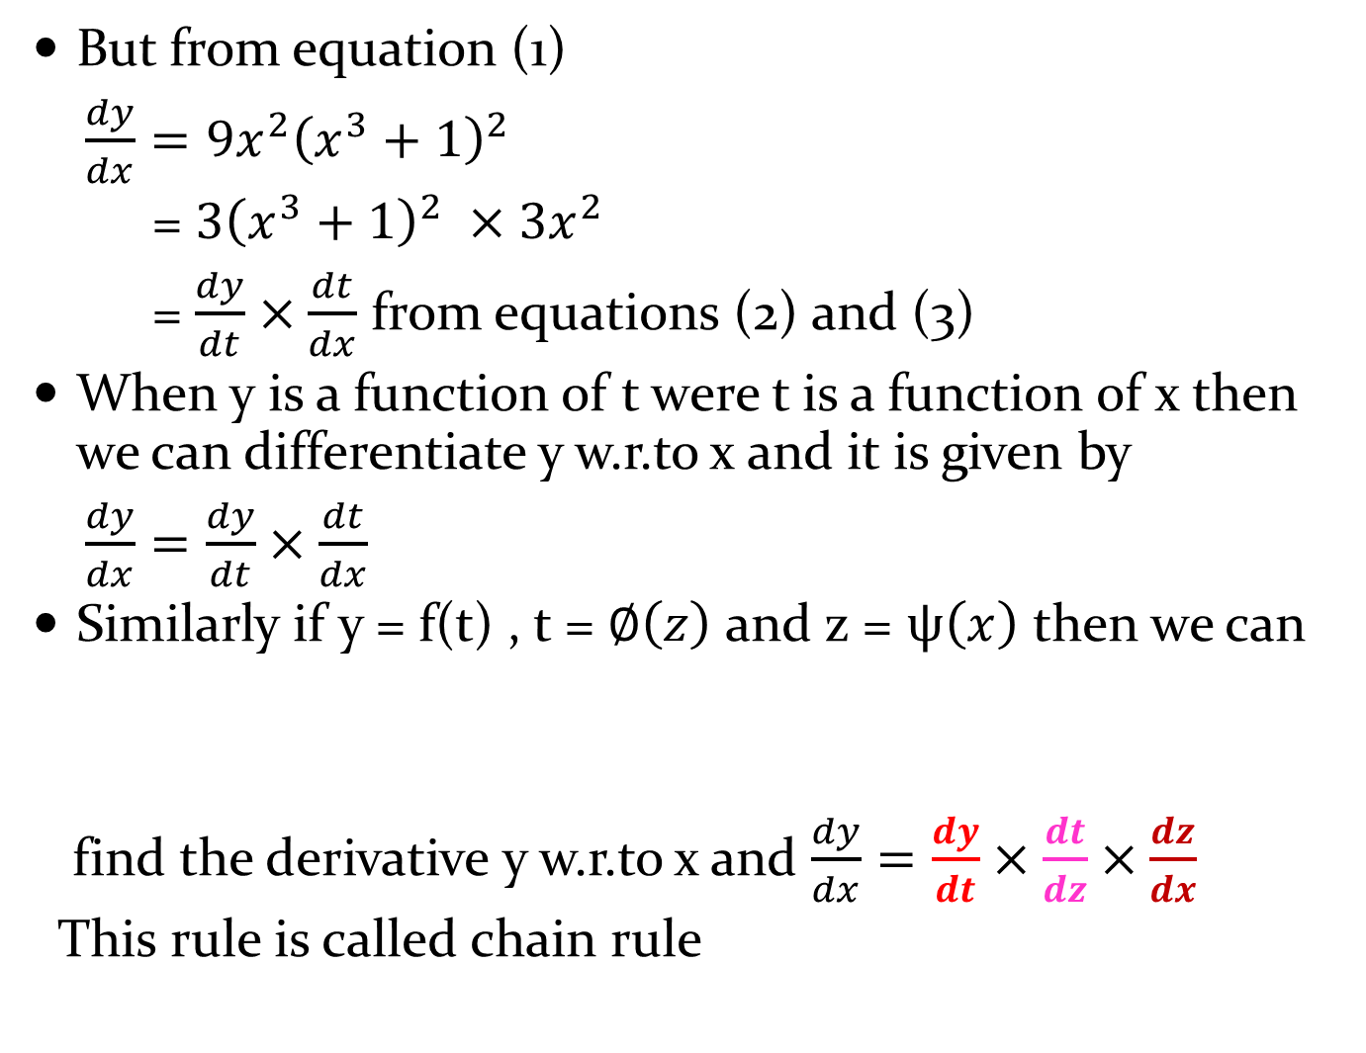


But from equation (1)
$\frac{dy}{dx}=9x^{2}{\left(x^{3}+1\right)}^{2}$
= $3{\left(x^{3}+1\right)}^{2} ×3x^{2}$
= $\frac{dy}{dt}×\frac{dt}{dx}$ from equations (2) and (3)
When y is a function of t were t is a function of x then we can differentiate y w.r.to x and it is given by
$\frac{dy}{dx}=\frac{dy}{dt}×\frac{dt}{dx}$
Similarly if y = f(t) , t = $∅\left(z\right)$ and z = $ψ\left(x\right)$ then we can
find the derivative y w.r.to x and $\frac{dy}{dx}=\frac{dy}{dt}×\frac{dt}{dz}×\frac{dz}{dx}$
This rule is called chain rule
$$\frac{dy}{dt}$$
$$\frac{dt}{dz}$$
$$\frac{dz}{dx}$$

Slide 7
DERIVATIVES OF IMPLICIT FUNCTIONS
If in a function the dependent variable y can be explicitly written in terms of independent variable x i.e. in terms of 'x' must not involve y in any manner then the function is called an explicit function e.g.
1) y = x² + 1 2) y = sin2x + cos 3x
If the dependent variable y and independent variable x are so convoluted in an equation that y cannot be written explicitly as function of x then f(x) is said to be an implicit function.
e.g. x² + y² = tan⁻¹ xy.
Steps used to find the derivative of Implicit functions

Slide 8
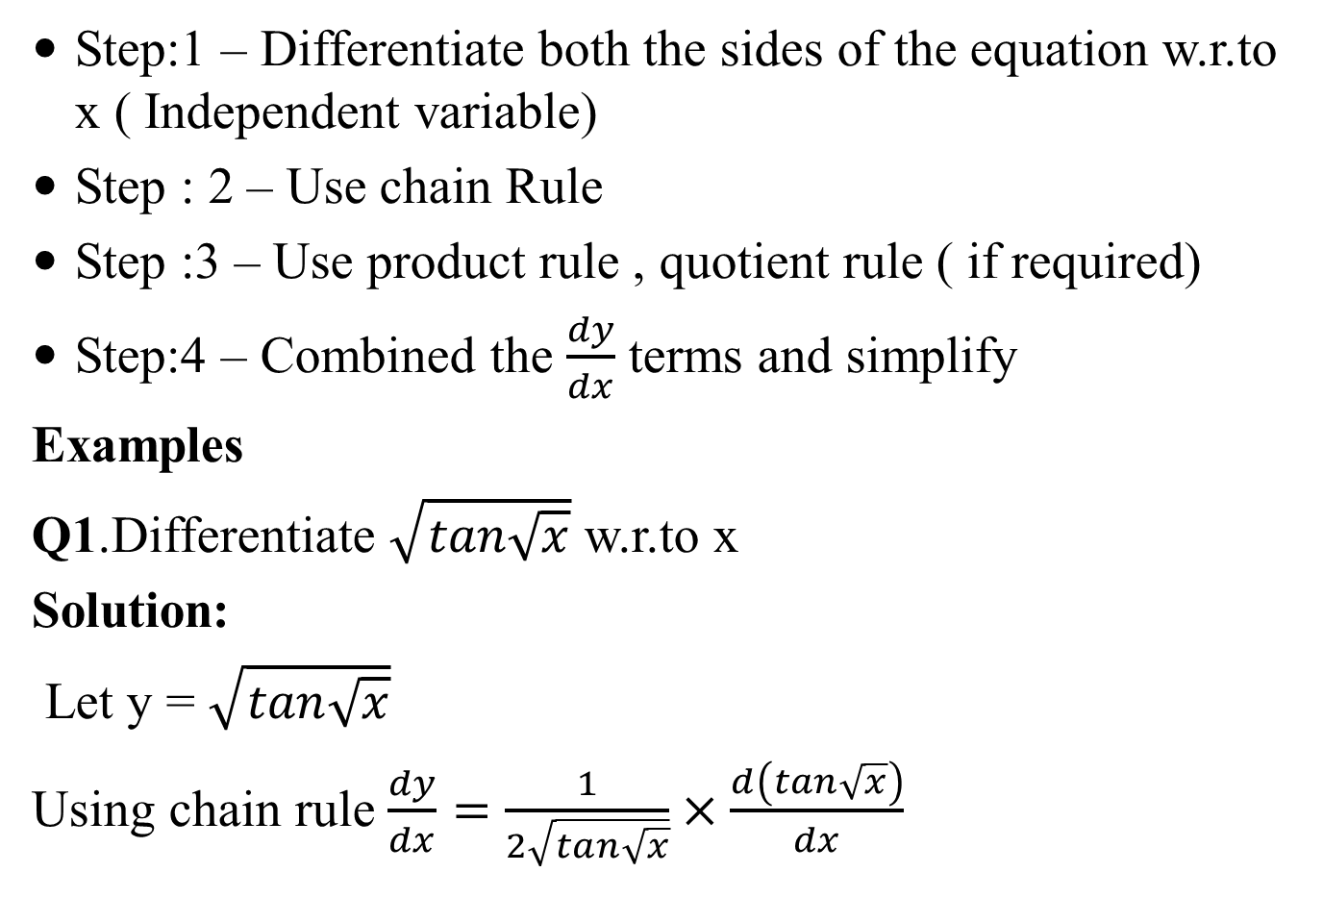
Step:1 – Differentiate both the sides of the equation w.r.to x ( Independent variable)
Step : 2 – Use chain Rule
Step :3 – Use product rule , quotient rule ( if required)
Step:4 – Combined the $\frac{dy}{dx}$ terms and simplify
Examples
Q1.Differentiate $\sqrt{tan\sqrt{x}}$ w.r.to x
Solution:
Let y = $\sqrt{tan\sqrt{x}}$
Using chain rule $\frac{dy}{dx}=\frac{1}{2\sqrt{tan\sqrt{x}}}×\frac{d\left(tan\sqrt{x}\right)}{dx}$

Slide 9
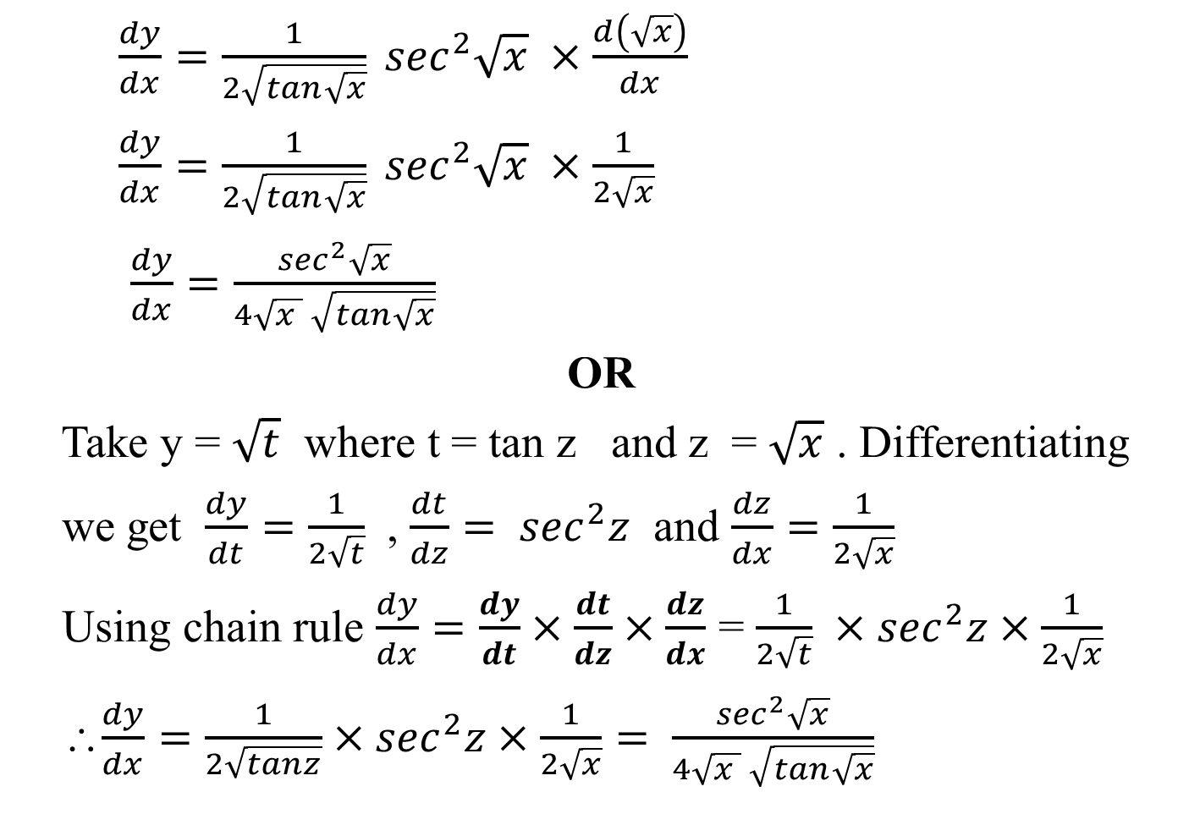
$\frac{dy}{dx}=\frac{1}{2\sqrt{tan\sqrt{x}}} \sec^{2}\sqrt{x} ×\frac{d\left(\sqrt{x}\right)}{dx}$
$\frac{dy}{dx}=\frac{1}{2\sqrt{tan\sqrt{x}}} \sec^{2}\sqrt{x} ×\frac{1}{2\sqrt{x}}$
$\frac{dy}{dx}=\frac{\sec^{2}\sqrt{x}}{4\sqrt{x } \sqrt{tan\sqrt{x}}}$
OR
Take y = $\sqrt{t}$ where t = tan z and z = $\sqrt{x}$ . Differentiating
we get $\frac{dy}{dt}=\frac{1}{2\sqrt{t}}$ , $\frac{dt}{dz}= \sec^{2}z$ and $\frac{dz}{dx}=\frac{1}{2\sqrt{x}}$
Using chain rule $\frac{dy}{dx}=\frac{dy}{dt}×\frac{dt}{dz}×\frac{dz}{dx}$ = $\frac{1}{2\sqrt{t}} ×\sec^{2}z×\frac{1}{2\sqrt{x}}$
∴$\frac{dy}{dx}=\frac{1}{2\sqrt{tanz}}×\sec^{2}z×\frac{1}{2\sqrt{x}}= \frac{\sec^{2}\sqrt{x}}{4\sqrt{x } \sqrt{tan\sqrt{x}}}$

Slide 10
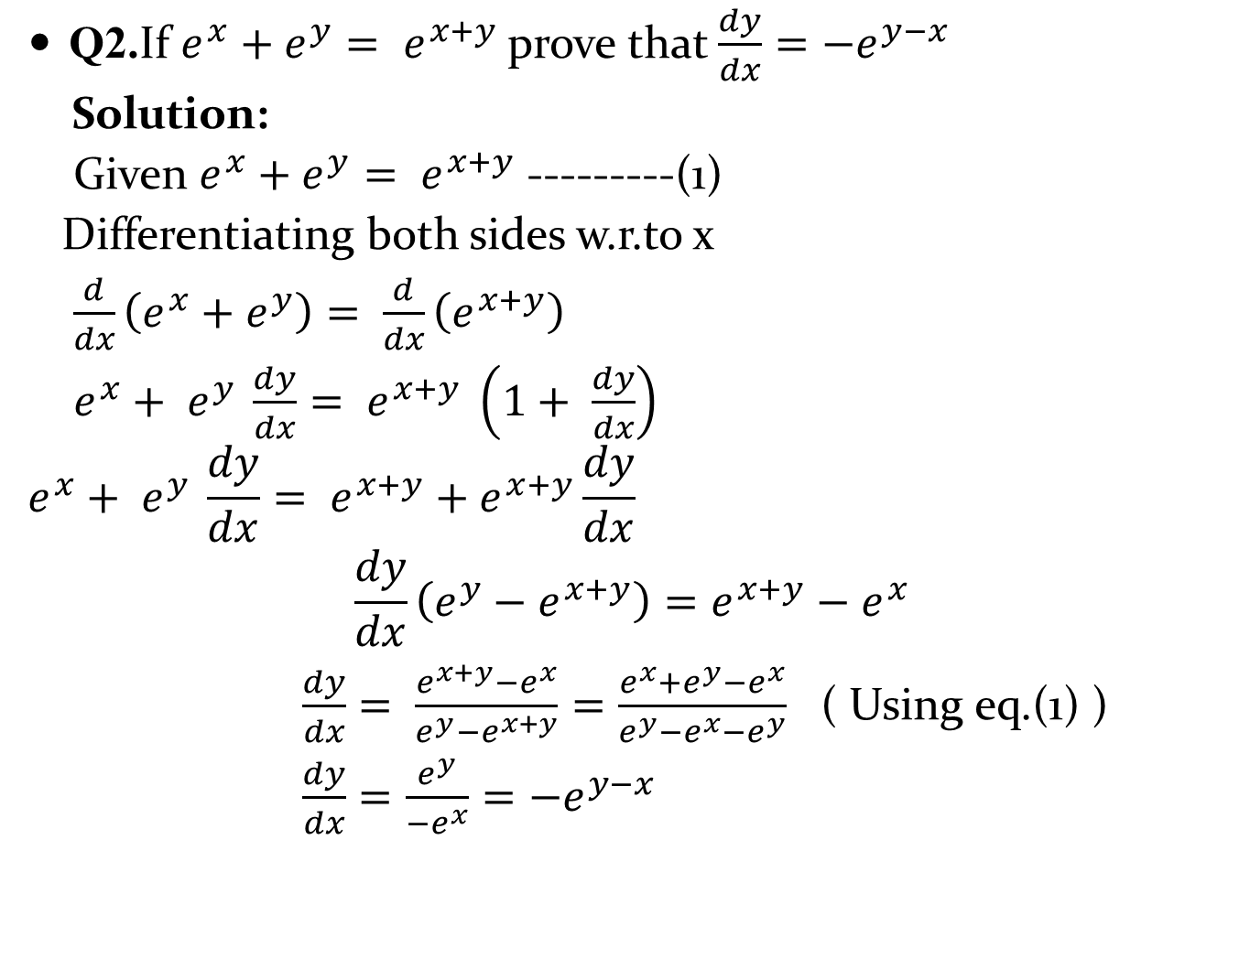
Q2.If $e^{x}+e^{y}= e^{x+y}$prove that $\frac{dy}{dx}=−e^{y−x}$
Solution:
Given $e^{x}+e^{y}= e^{x+y}$ ---------(1)
Differentiating both sides w.r.to x
$\frac{d}{dx}\left(e^{x}+e^{y}\right)= \frac{d}{dx}\left(e^{x+y}\right)$
$e^{x}+ e^{y} \frac{dy}{dx}= e^{x+y} \left(1+ \frac{dy}{dx}\right)$
$$e^{x}+ e^{y} \frac{dy}{dx}= e^{x+y}+e^{x+y}\frac{dy}{dx}$$
$$\frac{dy}{dx}\left(e^{y}−e^{x+y}\right)=e^{x+y}−e^{x}$$
$\frac{dy}{dx}= \frac{e^{x+y}−e^{x}}{e^{y}−e^{x+y}}=\frac{e^{x}+e^{y}−e^{x}}{e^{y}−e^{x}−e^{y}}$ ( Using eq.(1) )
$\frac{dy}{dx}=\frac{e^{y}}{−e^{x}}=−e^{y−x}$

Slide 11
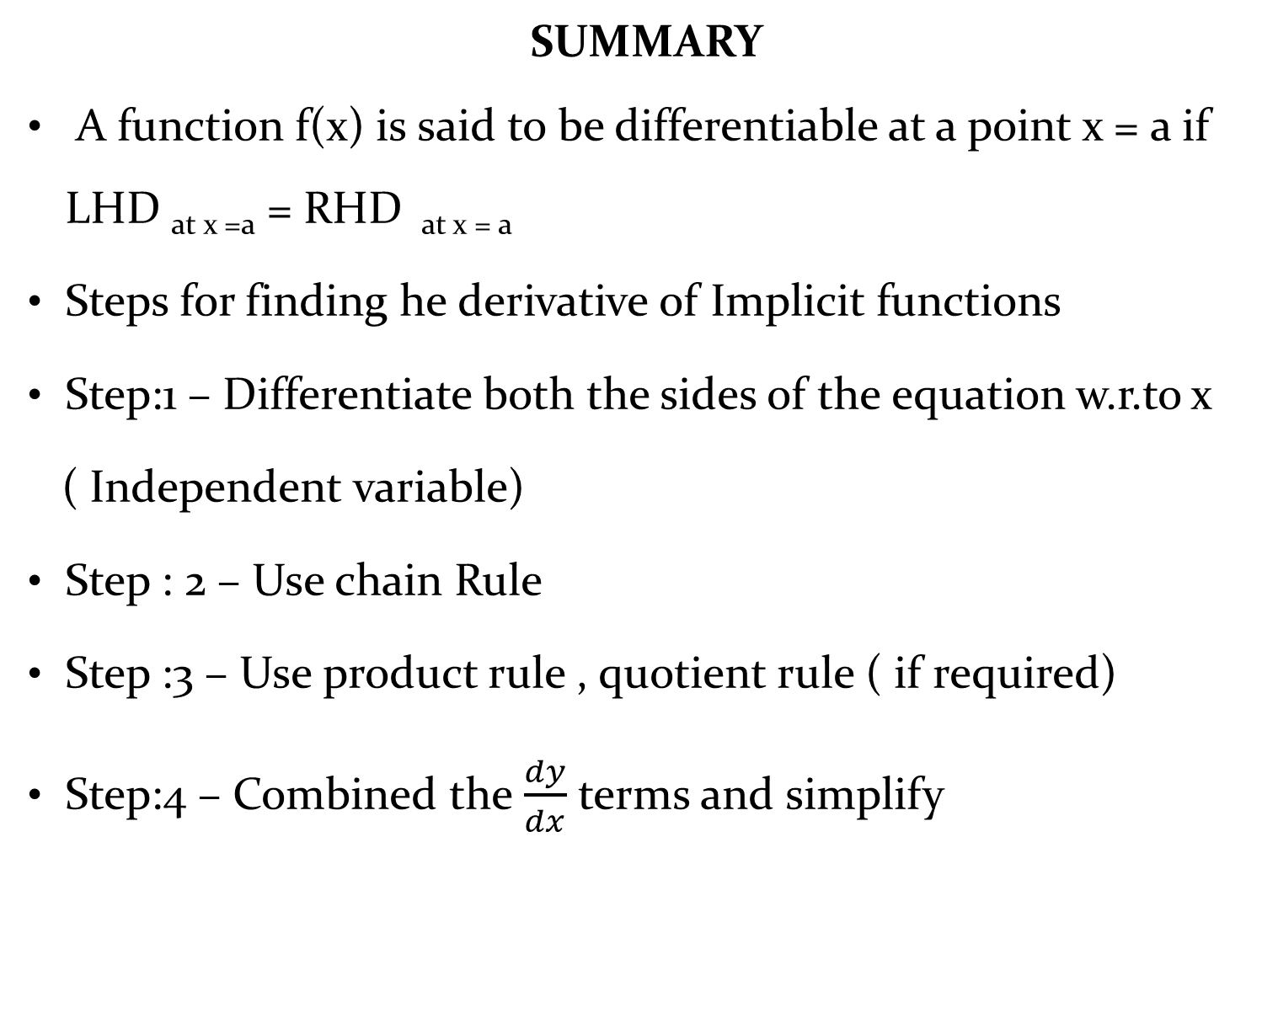
SUMMARY
A function f(x) is said to be differentiable at a point x = a if LHD _{at x =a} = RHD _{at x = a}
Steps for finding he derivative of Implicit functions
Step:1 – Differentiate both the sides of the equation w.r.to x
( Independent variable)
Step : 2 – Use chain Rule
Step :3 – Use product rule , quotient rule ( if required)
Step:4 – Combined the $\frac{dy}{dx}$ terms and simplify

Slide 12
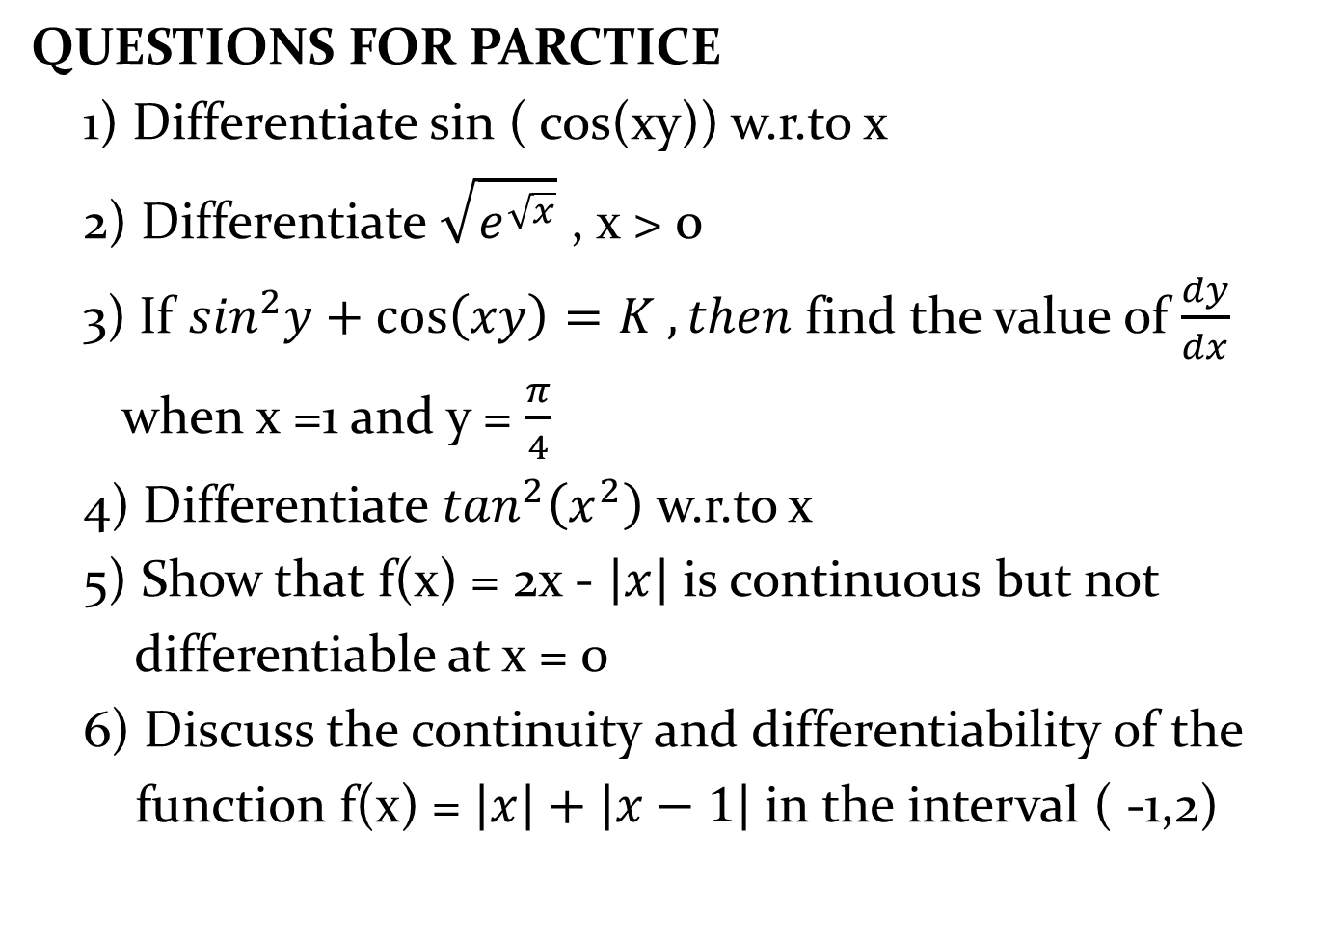
QUESTIONS FOR PARCTICE
1) Differentiate sin ( cos(xy)) w.r.to x
2) Differentiate $\sqrt{e^{\sqrt{x}}}$ , x > 0
3) If $\sin^{2}y+\cos\left(xy\right)=K , then$find the value of $\frac{dy}{dx}$
when x =1 and y = $\frac{π}{4}$
4) Differentiate $\tan^{2}\left(x^{2}\right)$ w.r.to x
5) Show that f(x) = 2x - $\left|x\right|$ is continuous but not
differentiable at x = 0
6) Discuss the continuity and differentiability of the
function f(x) = $\left|x\right|+\left|x−1\right|$ in the interval ( -1,2)

